Slide 1

Automated Topic Modeling Pipeline For Conversational Data
Ruchi Asthana

Slide 2
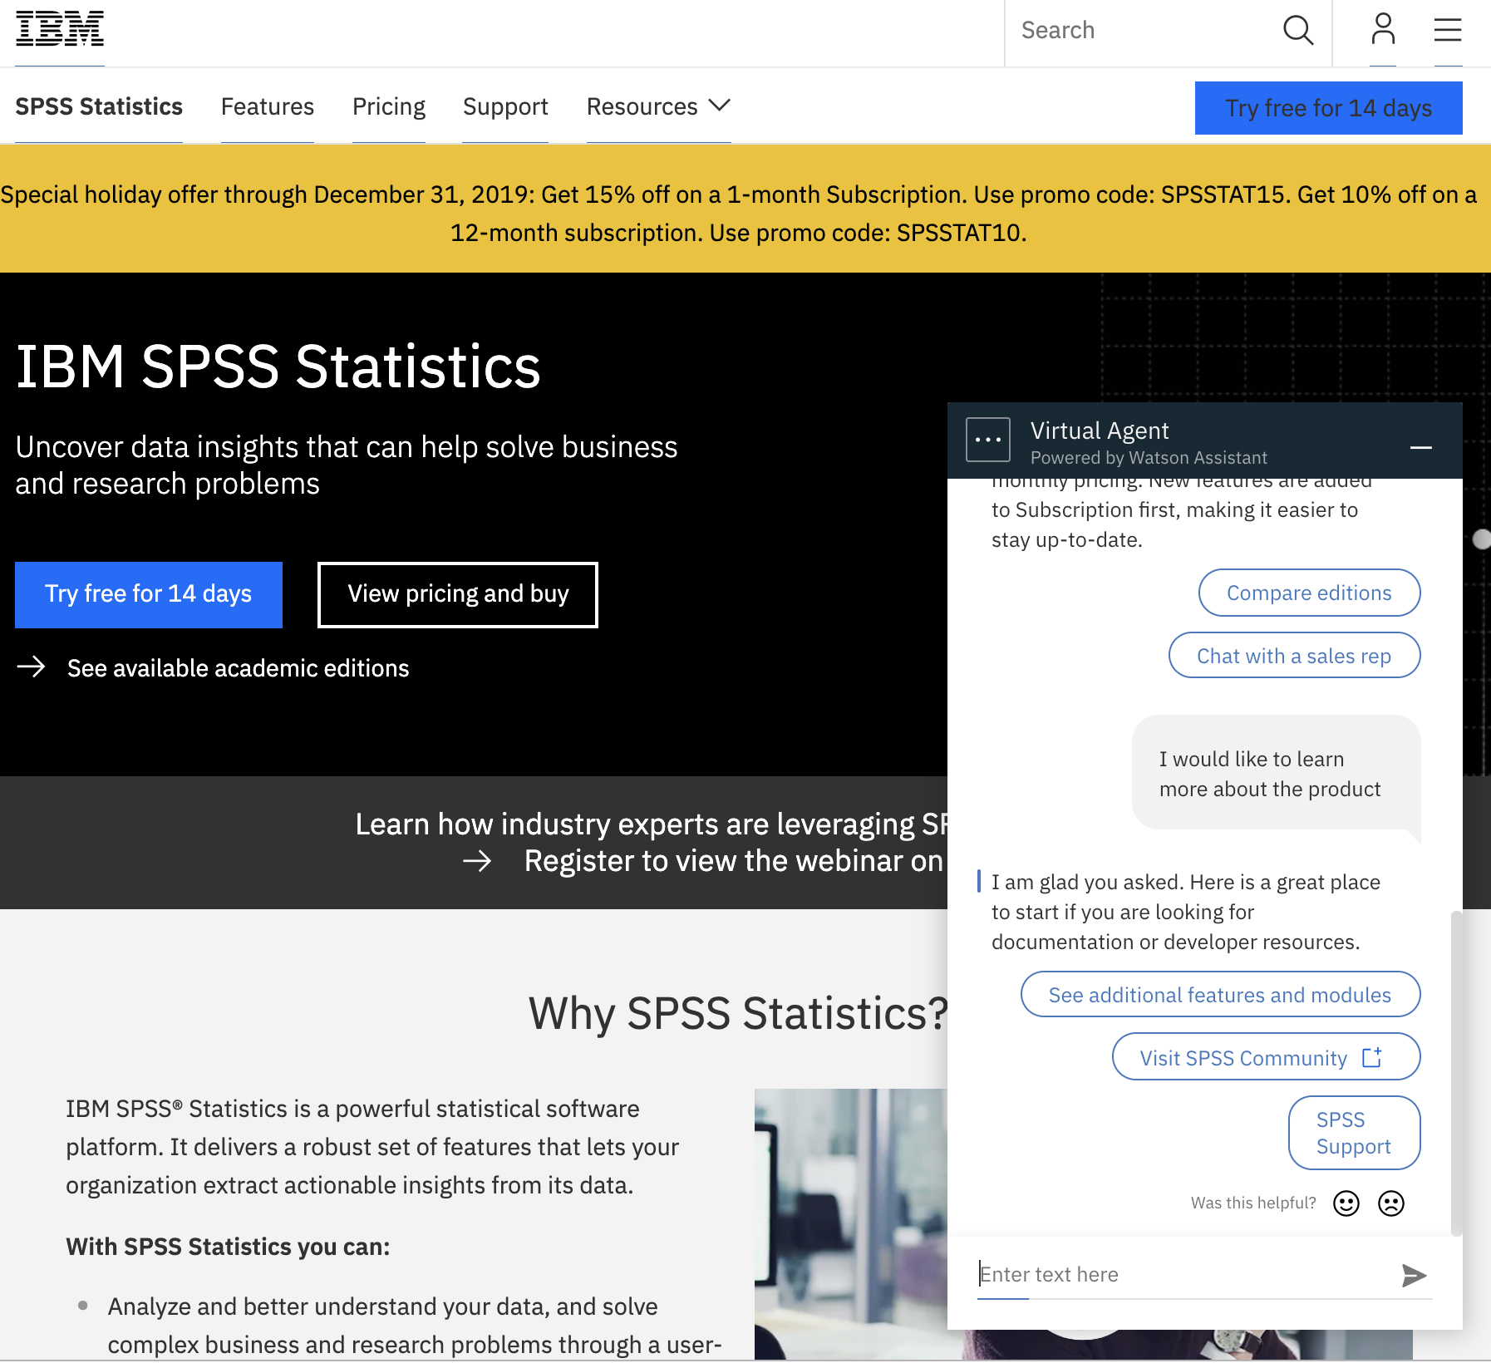
Project Objective
Our team handles inbound communications on product specific webpages through platforms like chat. We have accrued a lot of conversation data, and now our team would like to render some meaningful insights from it. A few things we are interested in:
Determining the Most Frequently Asked Topics
Identifying the Most Mentioned Terms and Services
Designing Effective Ways to Communicate this data to Non-Technical Project Teams and Stakeholders

Slide 3
Topic Modeling
Topic modeling is a type of statistical modeling for discovering the abstract “topics” that occur in a collection of documents. Latent Dirichlet Allocation (LDA) is an example of topic model and is used to classify text in a document to a particular topic. It builds a topic per document model and words per topic model, modeled as Dirichlet distributions.
Topic Modeling

Slide 4
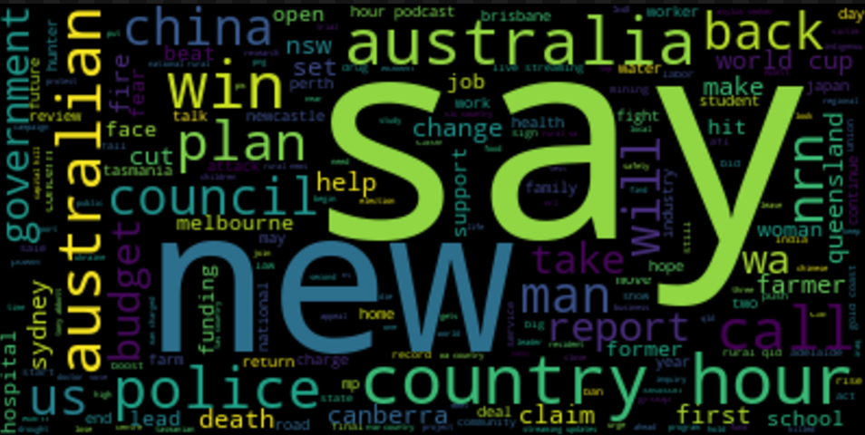
N-GRAM Analysis
N-Grams can be a very useful tool when trying to figure out which words and phrases are commonly expressed in a set of unstructured data. Analyzing trends in N-Grams can tell us what topics customers have started talking about, and what topics that have fallen out of favor. TF-IDF weightings can be applied to N-Gram extraction to narrow down the scope of bigrams and trigrams.

Slide 5



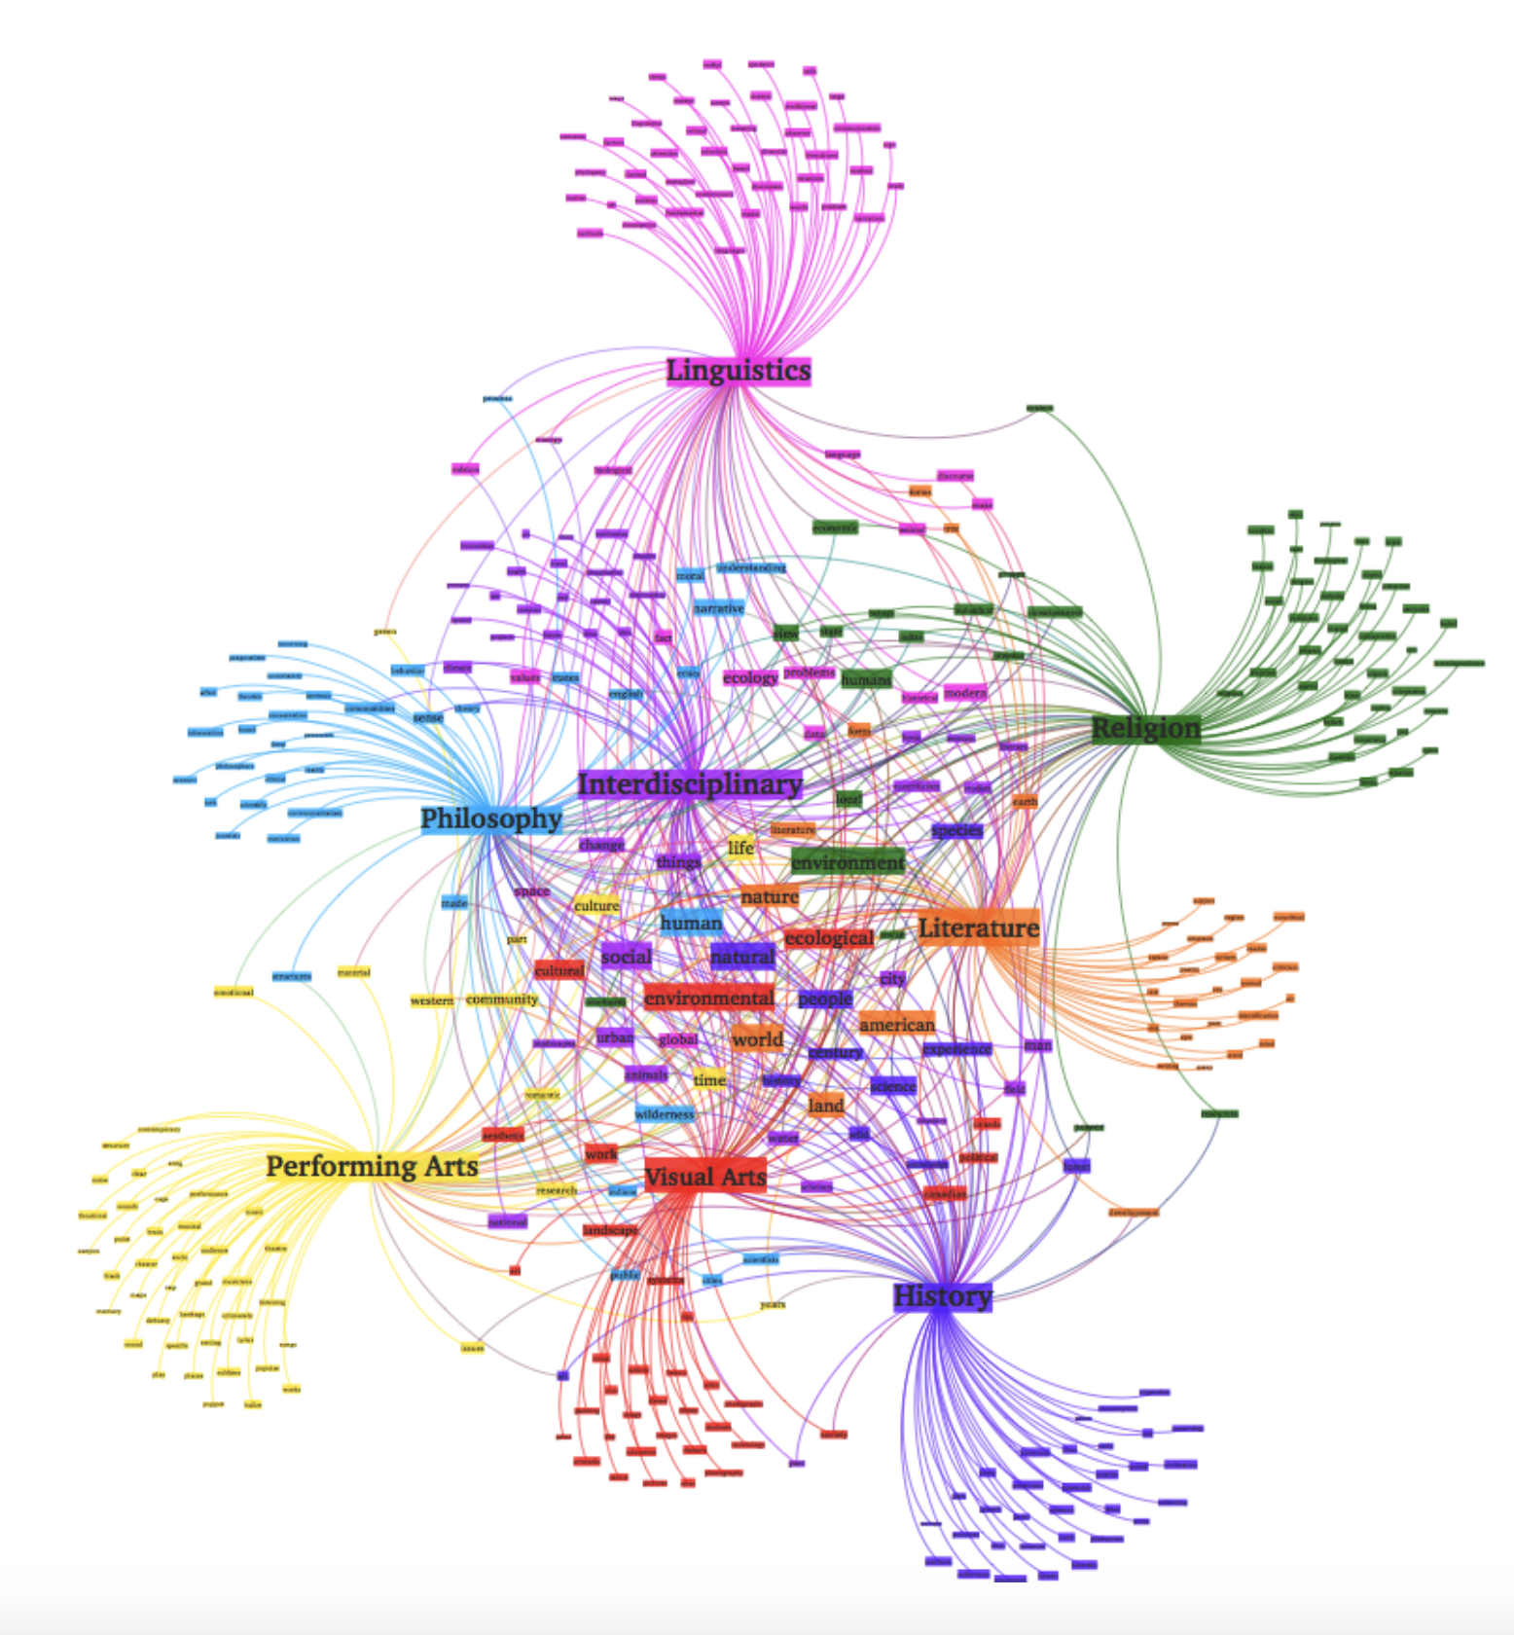
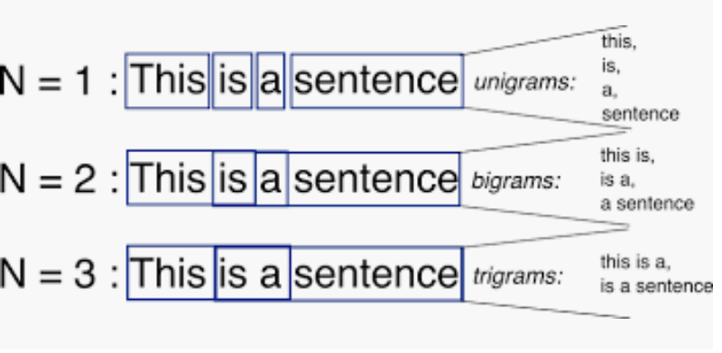
Data Processing
Load Data
class ArticleHeadlines
class CleanedHeadlines
-Tokenization
- Lemmatization
- Stemming
Topic Modeling
class ApplyTopicModeling
- Preprocess Documents
- Compare Topic Models
- LDA + TFIDF
- LDA
./data
/CleanedHeadline- [date]
Analysis
N-Gram Analysis
./output/TopicModeling
/CleanedHeadline-[salt]
Word Clouds

Slide 6
Improvements
integrate Pipeline with Cloudant (IBM Database)
add visualizations that communicate valuable insights
containerize my solution (Add KUBEFLOW)

